Slide 1
Understanding Fairness in Loan Origination Decisions

Slide 2
Context
GWU Project
Project on loan fairness
Used home mortgage loan application data
Developed a machine learning model
Laws
Home Mortgage Disclosure Act (HMDA) of 1975
Equal Credit Opportunity Act (ECOA) of 1974

Slide 3
The Need
Problem
Some institutions have discriminatory lending practices
No commonly agreed upon way to analyze unfairness in loan application results
Our Goal
Measure the fairness of loan origination decisions
With 2022 HMDA data

Slide 4
The Solution
Loan Fairness Tool
Uses data from 2,900+ financial institutions
Individual firm performance
Overall market performance
Who can use it
Federal agencies
Consumer Financial Protection Bureau (CFPB)
Department of Justice (DOJ)
Office of the Comptroller of the Currency (OCC)
Financial Institutions
Individuals

Slide 5
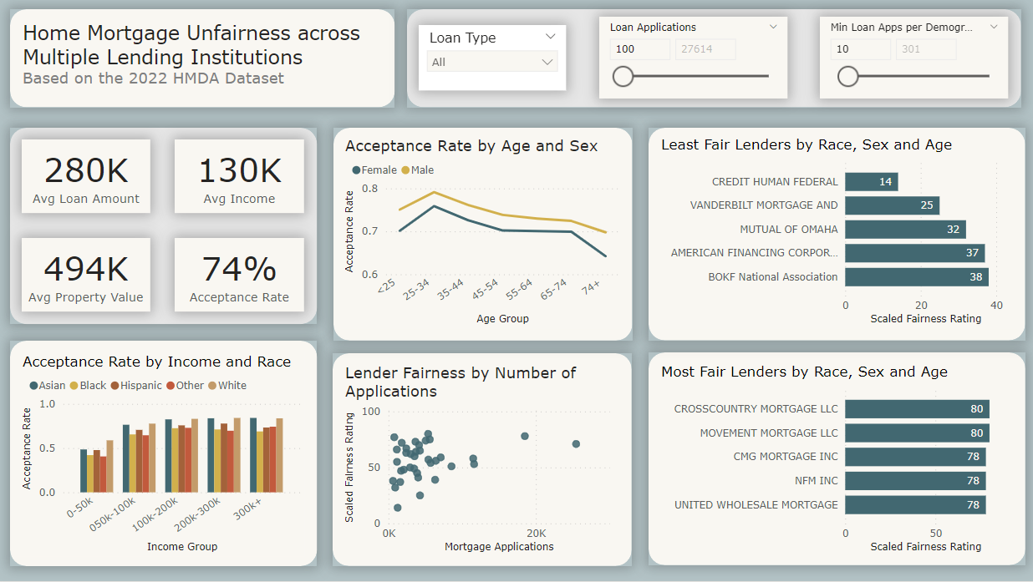
About the Tool
Fairness Scores
0-100 rating
Based on disparities in loan origination rates
Pages
Firm Lookup
Market
Metrics & Definitions
Relevant Terms
Demographic Parity
Equal Opportunity

Slide 6
Extensions
Rebuild the tool with better software
i.e. R Shiny
Allow HMDA dataset selection by year
Research potential clients

Slide 7
Further Learning
Standardizing fairness-evaluation procedures: interdisciplinary insights on machine learning algorithms in creditworthiness assessments for small personal loans | AI and Ethics (springer.com)

